Slide 1
IP Inter-carrier Routing
Capabilities to Support IP Services Interconnection
Gary Richenaker
Principal Solutions Architect
iconectiv
grichenaker@iconectiv.com
732-699-4701
August 6, 2014
Presented for:
FON

Slide 2
Overview
In an all-IP network a Registry should provide the following essential functions
Policy
Allows trusted interconnect partners to share certain interconnect and routing information
Rules
Record efficiency
Peering with other Registries
No monopoly
A Registry should download to local cache
Not require ENUM cross network query per call

Slide 3
Background
Service providers have been transitioning their networks to IP for many years
The industry has been exploring ENUM based telephone number registries for a number of years
Although not deployed, these experiences will be useful as the industry begins to conceptualize the future IP 10-digit line level database.
A number of initiatives have recently been created to take the transition to all-IP networks to the next step

Slide 4
Key Market Drivers
The ongoing deployment of LTE, and the need to provide interoperability, roaming, and IP based interconnection for the new Voice over LTE (VoLTE) and High Definition (HD) voice services that are being launched worldwide
Although telecommunications users are identified in different ways for different services (e.g., telephone number, email address, internet domain name, location routing number), telephone numbers remain a ubiquitous mechanism for subscribers to find each other

Slide 5
Industry Developments
The GSM Association (GSMA) and the i3forum recently launched an IP interconnection initiative to drive the deployment of VoLTE and new high quality IP communication services through commercial pilots
In the US, the FCC is focusing on the sunset of the PSTN

Slide 6
Industry Developments
ATIS, the North American organizational partner for 3GPP, and the SIP Forum announced a joint task force in January 2014 to fully specify an IP communications Network-to-Network Interface (NNI)
The goal is to ensure all service interconnection between providers can occur at the IP level end-to-end across wireless, wireline and cable providers

Slide 7
Challenge
Enable open access to IP services from a large number of providers to encourage innovation, competition, and a wide array of choice for consumers and businesses

Slide 8
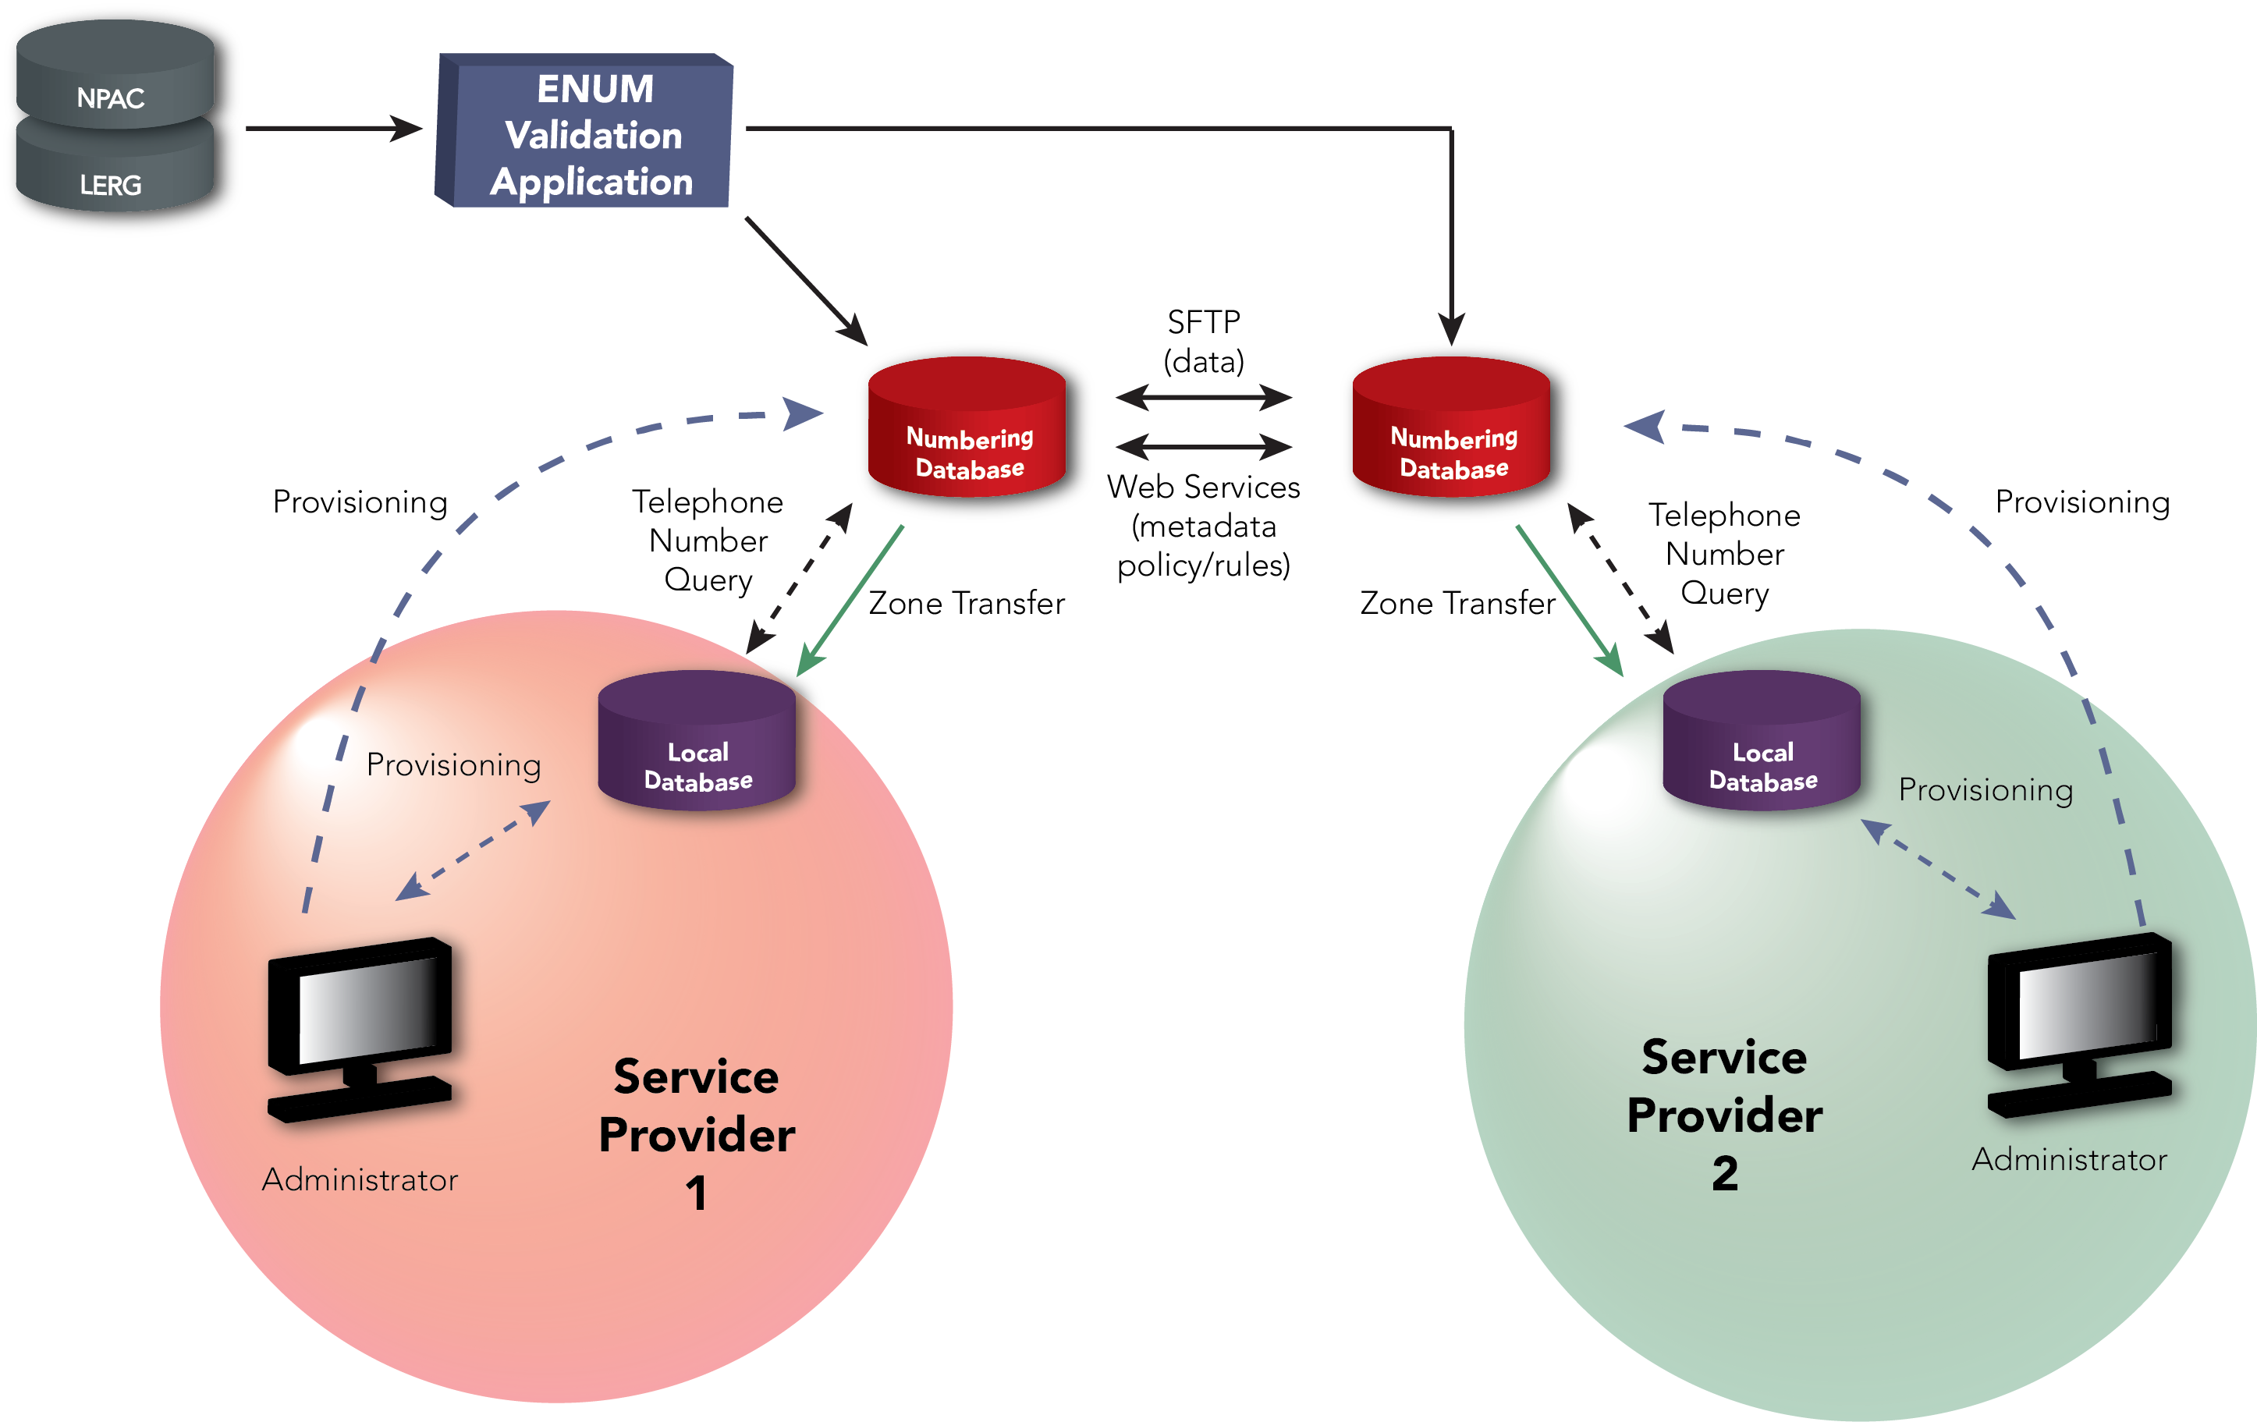
Peering Registry Reference Architecture

Slide 9
Registry Capabilities
Policy
Allows trusted interconnect partners to share certain interconnect and routing information with each other
Rules
Provide the ability to aggregate the telephone numbers into a grouping, e.g., OCN, NPA-NXX, LRN, etc., or assign different attributes to a telephone number
Peering
Allows for multiple registry providers to synchronize with each other and offer the same authoritative data to their respective customers.

Slide 10
Policy
Allow for different Name Server records
Depending on the originating & terminating service provider combination, the registry could be configured with policy for source based resolution using a “Recipient Group” feature
For example, some authorized Service Providers of Record might input Name Server information for the same TN that in one case refers to the Tier 2 Name Server of a transit operator or Internetwork Packet Exchange (IPX) and in another case refers to their own terminating Tier 2 Name Server when they are peering or interconnecting directly with the originating service provider
The Service Provider that provisions the data will also likely define one or more selective lists of Data Recipients
Data is not given to unauthorized parties
Service providers determine the content of the Name Authority Pointer (NAPTR) records returned in response to ENUM queries

Slide 11
Rules
The number of records stored in an IP Interconnection Registry could be tens or hundreds of millions based on the need to assign different characteristics per TN
A single change can ripple through the data and touch a vast number of records
A rule that aggregates a number of TNs into a block such as NPA-NXX or NPA-NXX_X can dramatically reduce the number of records that need to be provisioned because it enables higher-level groupings that provide a compressed record set
For example, an NS or NAPTR record value could be assigned to each Operating Company Number (OCN) rather than to each telephone number or, to each unique Service Provider ID (SPID) and/or NPA/NXX or Location Routing Number (LRN)

Slide 12
Rules- cont’d
A single telephone number may be associated with several services, e.g., HD voice, Instant Messaging (IM), and IP telephony
The calling network needs to determine whether the called party has the requested service prior to setting up the call
A purpose-built registry can accommodate various service attributes at a TN level as well as at coarser levels based on rules established by the Service Provider
The use of rules allows the industry to provision services against higher levels of abstraction which optimize the number of records in the registry and especially in a local (cache) database

Slide 13
Mitigating the Impact of ENUM
Can we eliminate the cross-network queries and avoid the overhead of maintaining tier2 server farms?
NPAC can store the URIs and distribute locally through LSMS or XML downloads
However there is no policy in NPAC so all interconnecting parties will receive the same URI info
Vendor development required on SOA and LSMS tools
BIRDDS can store the NS or URIs and distribute locally via LERG file downloads
However there is also no policy in LERG so all interconnecting parties will receive the same URI info
Not currently storing routing data on full 10 digit TNs

Slide 14
Mitigating the Impact of ENUM- cont’d
Registry could optionally be used by service providers to capture and exchange NAPTR records instead of just NS records thereby combining Tier 2 functionality in the Tier 1 Registry
This could be optional according to terminating service provider discretion and would be transparent to the originating service provider
This would enable ENUM implementation without the complexity of cross network queries
Registry can download data to local cache

Slide 15
Registry Interworking
Examination of the often-heard statement that there can be “no more than one National ENUM Registry” because of synchronization issues
One obstacle to achieving synchronization is the quantity of data involved
The time taken to distribute a large number of changed records puts a lower bound on the time scale over which the Registries can be considered to be synchronized
However, it is often not necessary to distribute the changed records explicitly
Each registry includes a policy language and rule set that operates on the data’s metadata, unambiguously and completely describing the changes
Each registry uses the same policy language in conjunction with the established rules to describe changes sent and to interpret changes received

Slide 16
Registry Interworking – cont’d
The FTP-based component relies on a file naming convention and an agreed-upon directory structure which is consistent over all participants
The file names contain an identifier for the intended recipient and a timestamp
The files are named either ALL or INCR
The INCR (Incremental) files contain only changes to data made during the last hour, whereas
the ALL files are a dump of the entire database, written every 24 hours
The Web Services component provides near-real-time response
Each registry commits to exposing changes on the Web Services interface within a matter of seconds, and other Registries poll the interface as often as desired, typically every 15 seconds

Slide 17
Registry Interworking – cont’d
As the migration to a service rich IP environment occurs, multiple ENUM registries can co-exist and it is important to enable peering capability
As an example, this overall architecture already exists within the TV White Spaces industry
The Whitespaces Database Administrators (WSDBA) group has defined an architecture and an Interoperability Specification
(http://apps. fcc.gov/ecfs/document/view?id=7520963472)

Slide 18
Summary
As more and more telecommunications services are designed for, or migrate to, IP an authoritative means for identifying telecommunications users and services reachable via IP will become a prerequisite to operate at scale
For example, VoIP, VoLTE, high definition voice, messaging, and M2M communications
A standards-based mechanism will be needed for mapping a telephone number into IP addresses designating service-specific interconnection points
A trusted, centrally-managed IP interconnection registry for inter-carrier routing of IP services can be enabled and should provide three essential functions;
Policy during the provisioning process,
Rules based on routing granularity, and
The ability to support multiple competing IP interconnection registries

Slide 19
Q&A
Thank you!

